Slide 1
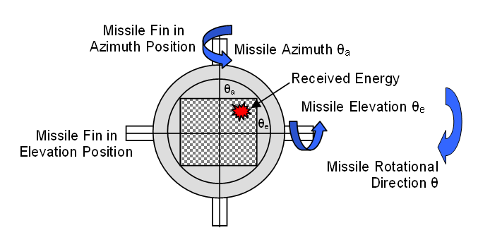
Problem Statement
Customer requests stability analysis for laser guided missile
Design control system if missile is unstable
Requirements for Stability
  Less then 20% Over Shoot
  Reaches 2% Final Value in 0.6 Seconds

Slide 2
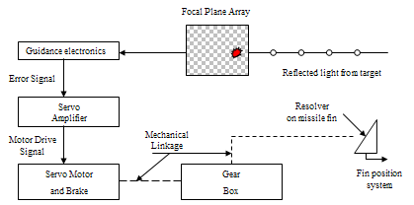
System Description

Slide 3
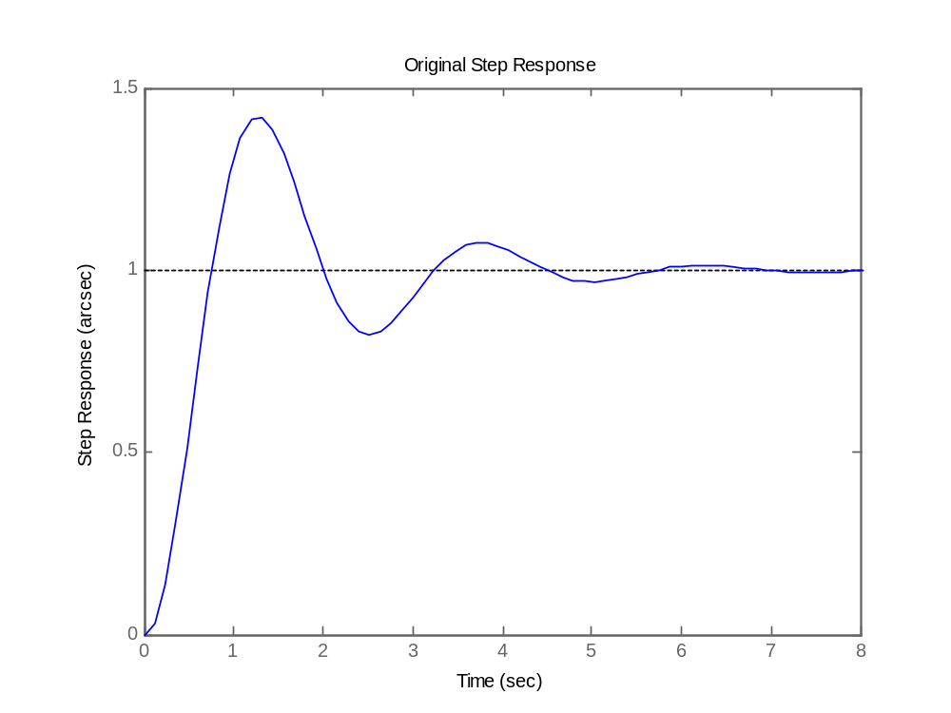
Step Response

Slide 4
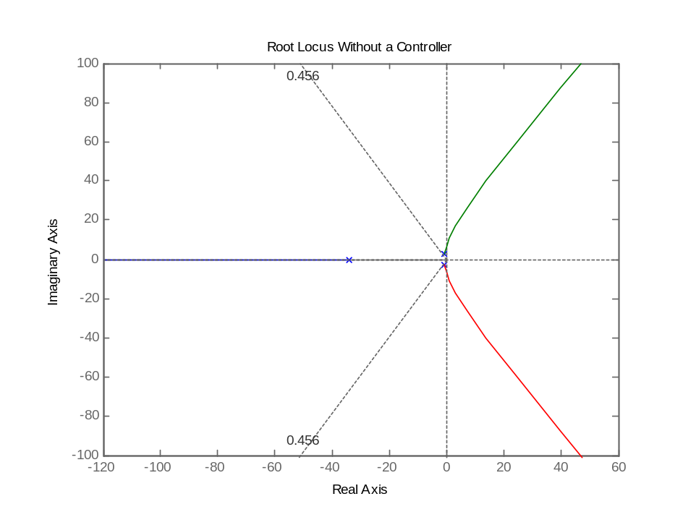
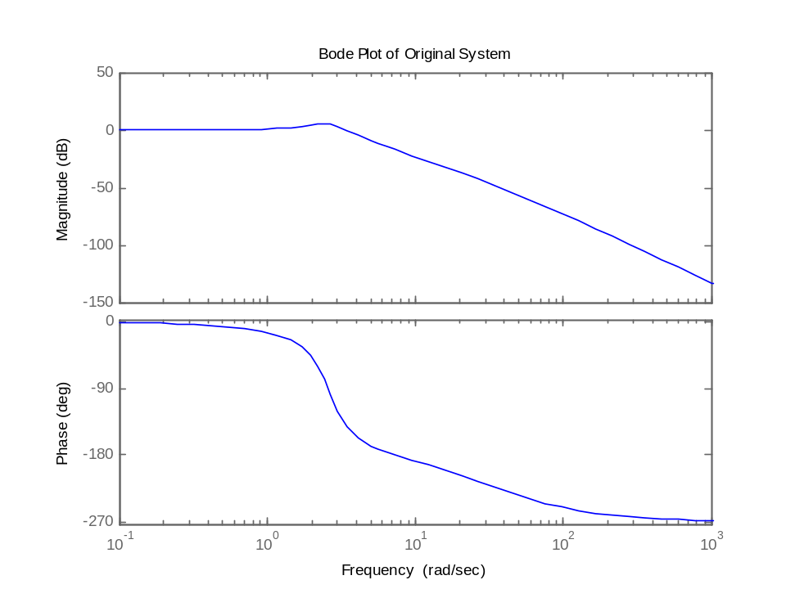
Original Response

Slide 5

AIM-7F/M Sparrow
Primary function: air-to-air missile.
Dimensions: Length 12 ft., diameter 8 in., wingspan 3 ft. 4 in.
Speed: 1750 mph; 782.32 m/s
Range: 14 miles; 22.531 km

Slide 6
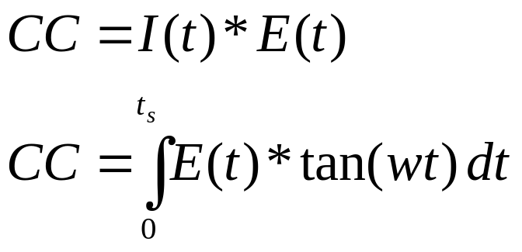
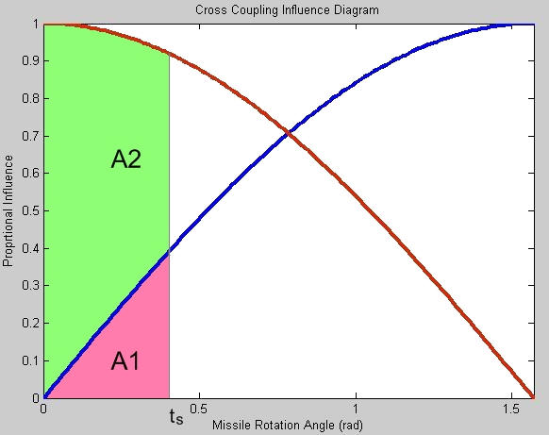
Cross Coupling
A1 area under azimuth curve
A2 area under elevation curve
I(t) – Influence Factor = A2/A1
E(t) – System Error
Azimuth
Elevation

Slide 7
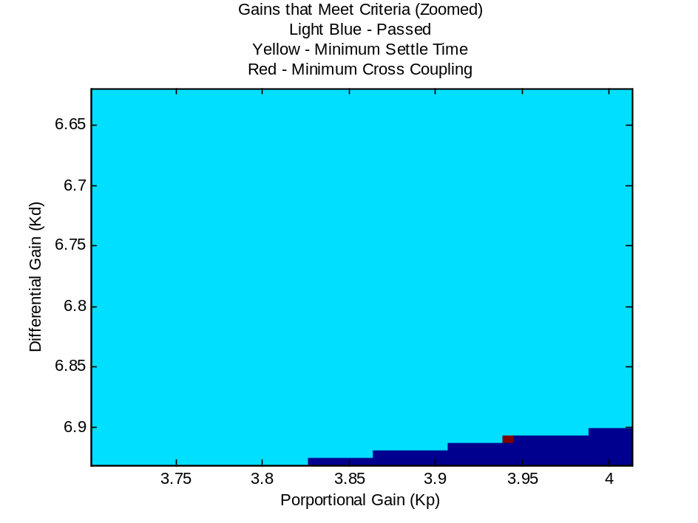
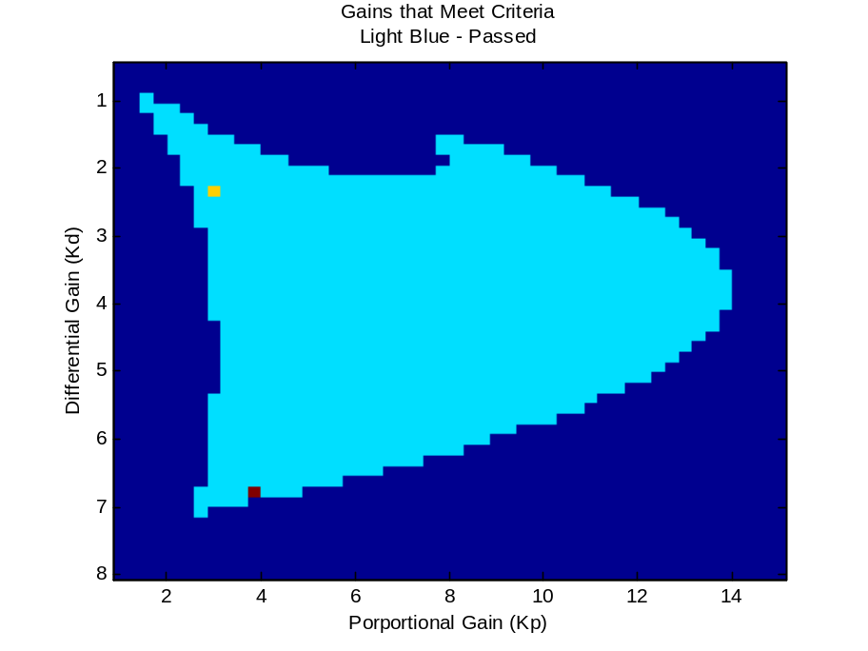
Gain Selection

Slide 8
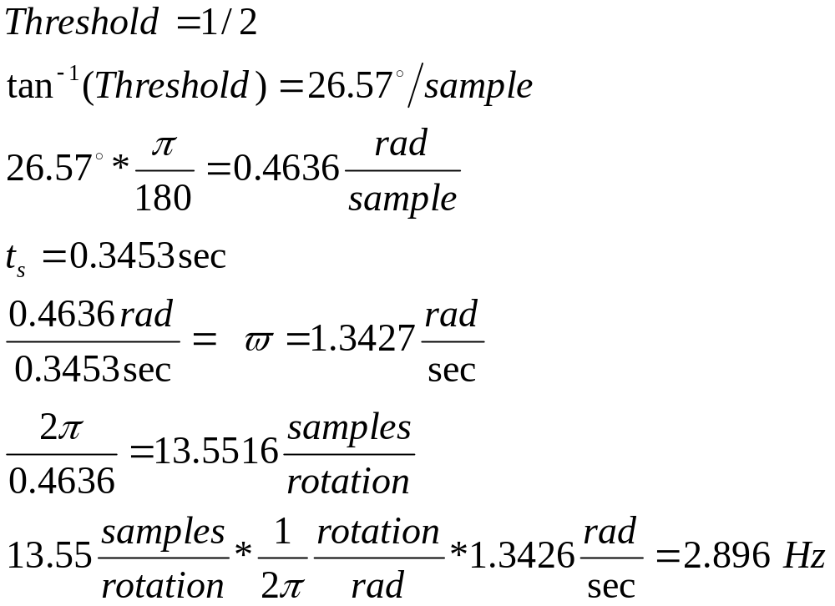
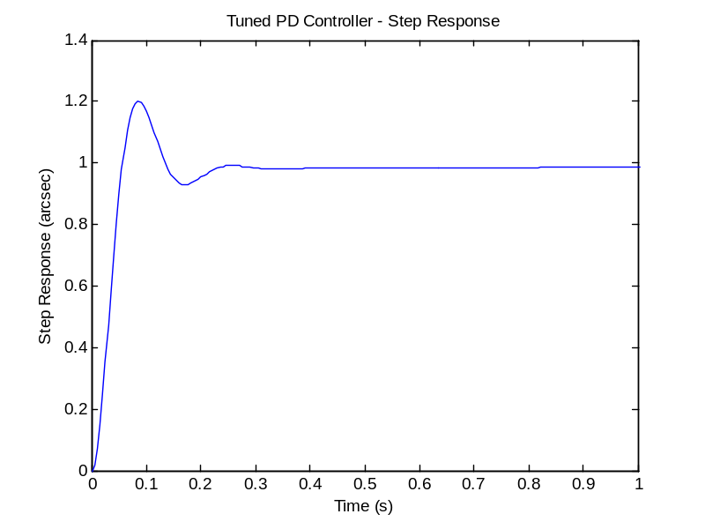
System Criteria

Slide 9
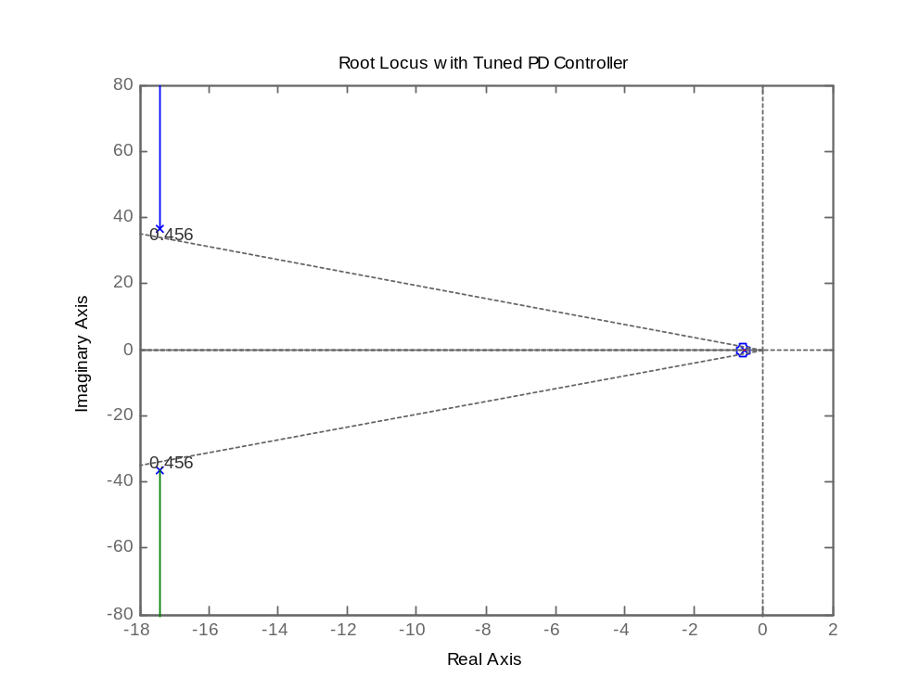
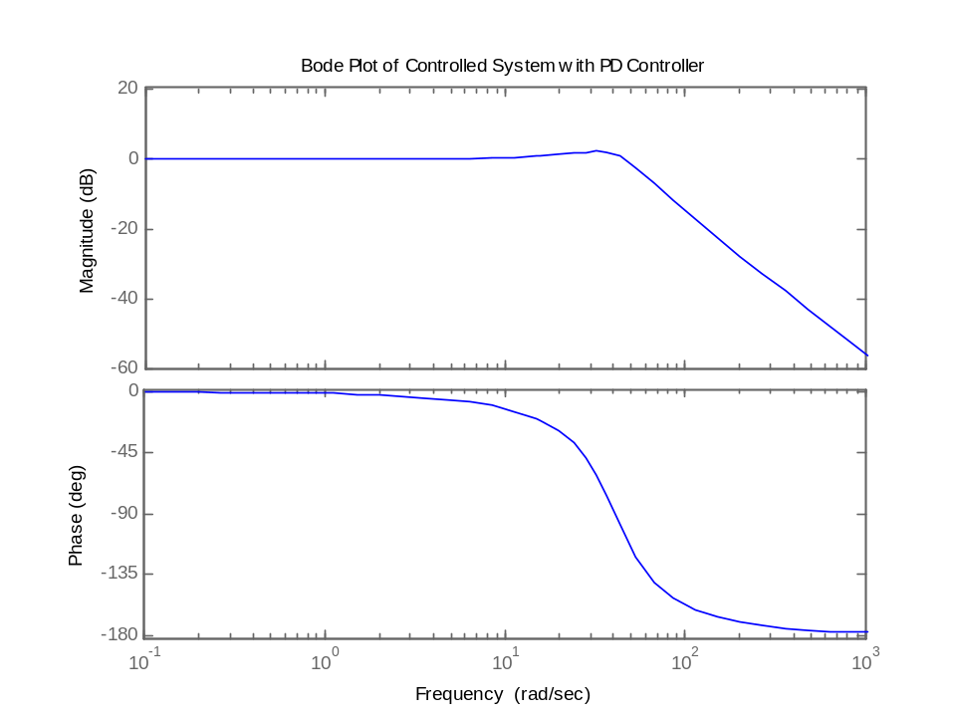
New Response

Slide 10
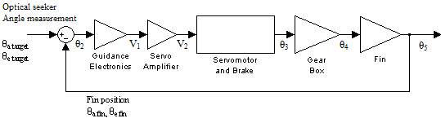
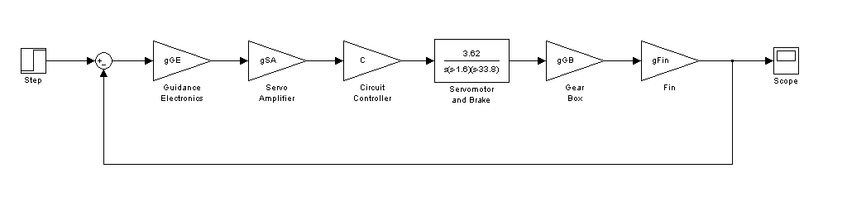
System Analysis
Original Block Diagram of Guided Missile
Proposed Block Diagram of Guided Missile

Slide 11
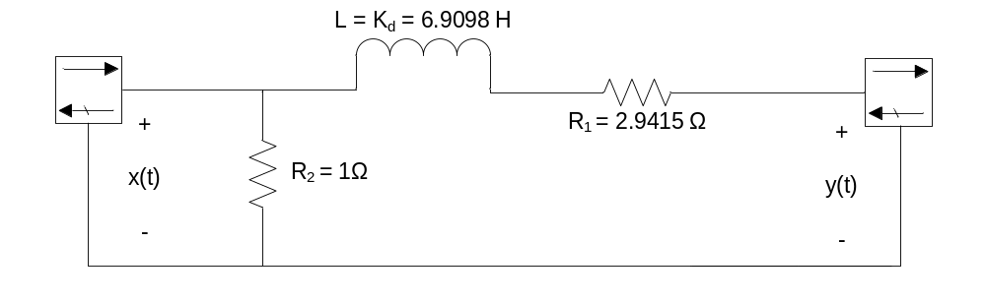
New Controller

Slide 12
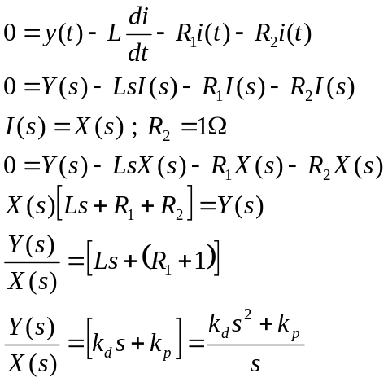
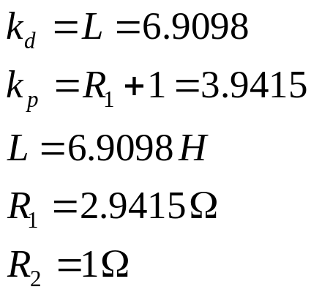
Circuit PD Controller

Slide 13
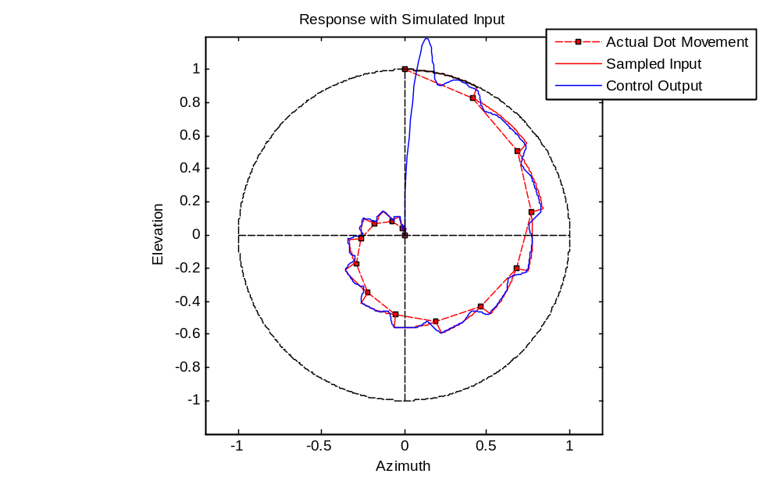
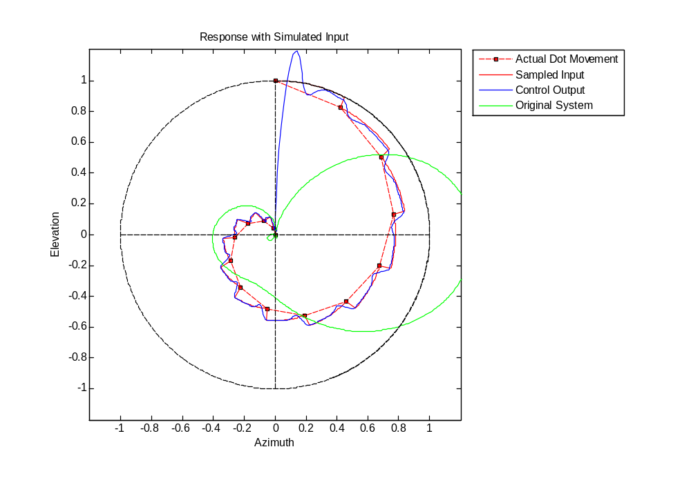
Results

